Slide 1
BCSE307L – COMPILER DESIGN

Slide 2
Course Outcomes
Apply the skills on devising, selecting, and using tools and techniques towards compiler design
Develop language specifications using context free grammars (CFG).
Apply the ideas, the techniques, and the knowledge acquired for the purpose of developing software systems.
Constructing symbol tables and generating intermediate code.
Obtain insights on compiler optimization and code generation

Slide 3
Syllabus
Module: 1 Introduction to Compilation and Lexical Analysis 7 hours
Introduction to LLVM - Structure and Phases of a Compiler-Design Issues-Patterns Lexemes-Tokens-Attributes-Specification of Tokens-Extended Regular Expression- Regular expression to Deterministic Finite Automata (Direct method) - Lex - A Lexical Analyzer Generator
Module: 2 Syntax Analysis 8 hours
Role of Parser- Parse Tree - Elimination of Ambiguity – Top Down Parsing – Recursive Descent Parsing - LL (1) Grammars – Shift Reduce Parsers- Operator Precedence Parsing - LR Parsers, Construction of SLR Parser Tables and Parsing- CLR Parsing- LALR Parsing
Module: 3 Semantic Analysis 5 hours
Syntax Directed Definition – Evaluation Order - Applications of Syntax Directed Translation - Syntax Directed Translation Schemes - Implementation of L-attributed Syntax Directed Definition
Module: 4 Intermediate Code Generation 5 hours
Variants of Syntax trees - Three Address Code- Types – Declarations - Procedures - Assignment Statements - Translation of Expressions - Control Flow - Back Patching- Switch Case Statements.

Slide 4
Cont..
Module: 5 Code Optimization 6 hours
Loop optimizations- Principal Sources of Optimization -Introduction to Data Flow Analysis - Basic Blocks - Optimization of Basic Blocks - Peephole Optimization- The DAG Representation of Basic Blocks -Loops in Flow Graphs - Machine Independent Optimization Implementation of a naïve code generator for a virtual Machine- Security checking of virtual machine code
Module: 6 Code Generation 5 hours
Issues in the design of a code generator- Target Machine- Next-Use Information – Register Allocation and Assignment- Runtime Organization- Activation Records.
Module: 7 Parallelism 7 hours
Parallelization- Automatic Parallelization- Optimizations for Cache Locality and Vectorization- Domain Specific Languages-Compilation- Instruction Scheduling and Software Pipelining- Impact of Language Design and Architecture Evolution on Compilers Static Single Assignment
Module: 8 Contemporary Issues 2 hours

Slide 5
Token, Pattern & Lexemes

Slide 6
Interaction of scanner & parser
Token
Source Program
Lexical Analyzer
Parser
Get next token
Symbol Table
Upon receiving a “Get next token” command from parser, the lexical analyzer reads the input character until it can identify the next token.
Lexical analyzer also stripping out comments and white space in the form of blanks, tabs, and newline characters from the source program.
Another task is correlating error messages generated by the compiler with the source program
Notes:
For instance, the lexical analyzer may keep track of the number of newline characters seen, so it can associate a line number with each error message. In some compilers, the lexical analyzer makes a copy of the source program with the error messages inserted at the appropriate positions. If the source program uses a macro-preprocessor, the expansion of macros may also be performed by the lexical analyzer

Slide 7
Why to separate lexical analysis & parsing?
Simplicity in design.
Improves compiler efficiency.
Enhance compiler portability.
Notes:
For example, a parser that had to deal with comments and whitespace as syntactic units would be considerably more complex than one that can assume comments and whitespace have already been removed by the lexical analyzer.
Input-device-specic peculiarities can be restricted to the lexical analyzer.

Slide 8
Token, Pattern & Lexemes
Sequence of character having a collective meaning is known as token.
Categories of Tokens:
Identifier
Keyword
Operator
Special symbol
Constant
Pattern
Token
The set of rules called pattern associated with a token.
Example: “non-empty sequence of digits”, “letter followed by letters and digits”
The sequence of character in a source program matched with a pattern for a token is called lexeme.
Example: Rate, DIET, count, Flag
Lexemes

Slide 9
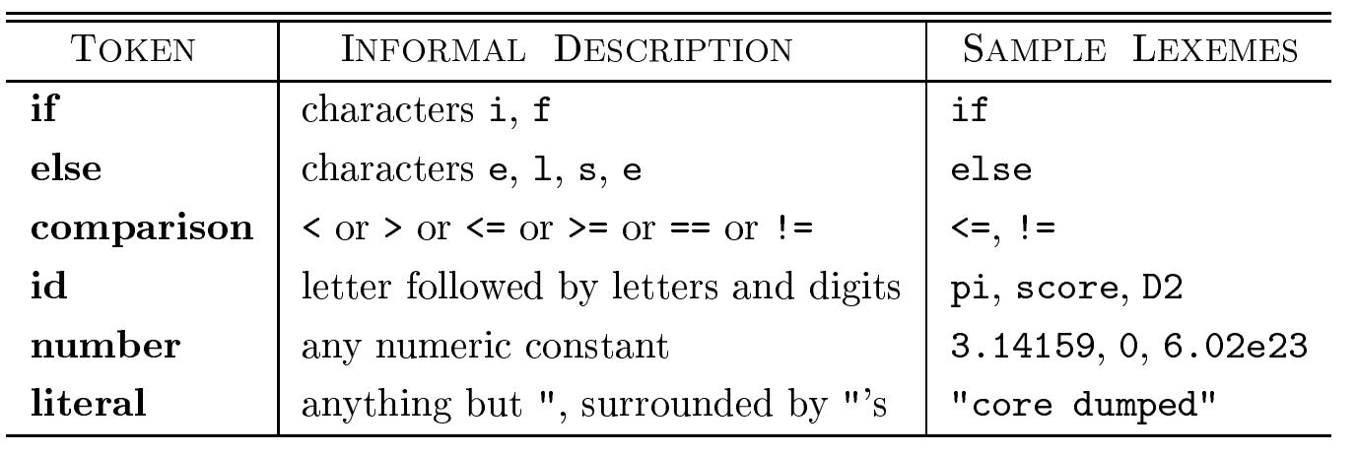
Example: Token, Pattern & Lexemes
C code:
printf("Total = %d\n", score);
printf and score are lexemes matching the pattern for token id,
"Total = %d\n" is a lexeme matching literal
In many programming languages, the following classes cover most or all of
the tokens:
Notes:
1. One token for each keyword. The pattern for a keyword is the same as the keyword itself. 2. Tokens for the operators, either individually or in classes such as the token comparison mentioned in Fig. 3.2. 3. One token representing all identifiers. 4. One or more tokens representing constants, such as numbers and literal strings. 5. Tokens for each punctuation symbol, such as left and right parentheses, comma, and semicolon

Slide 10
Example: Token, Pattern & Lexemes
Example: total = sum + 45
Tokens:
total
=
sum
+
45
Lexemes
Lexemes of identifier: total, sum
Lexemes of operator: =, +
Lexemes of constant: 45
Identifier1
Operator1
Tokens
Identifier2
Operator2
Constant1

Slide 11
Attributes of Tokens
When more than one lexeme can match a pattern, the lexical analyzer must provide the subsequent compiler phases additional information about the particular lexeme that matched.
For example, the pattern for token number matches both 0 and 1
Thus, in many cases the lexical analyzer returns to the parser not only a token name, but an attribute value that describes the lexeme represented by the token;
Normally, information about an identifier e.g., its lexeme, its type, and the location at which it is first found is kept in the symbol table. Thus, the appropriate attribute value for an identifier is a pointer to the symbol-table entry for that identifier.
The token names and associated attribute values for the Fortran statement E = M * C ** 2
are written below as a sequence of pairs.
<id, pointer to symbol-table entry for E>
<assign op>
<id, pointer to symbol-table entry for M>
<mult op>
<id, pointer to symbol-table entry for C>
<exp op>
<number, integer value 2>
Notes:
For example, the pattern for token number matches both 0 and 1, but it is extremely important for the code generator to know which lexeme was found in the source program

Slide 12
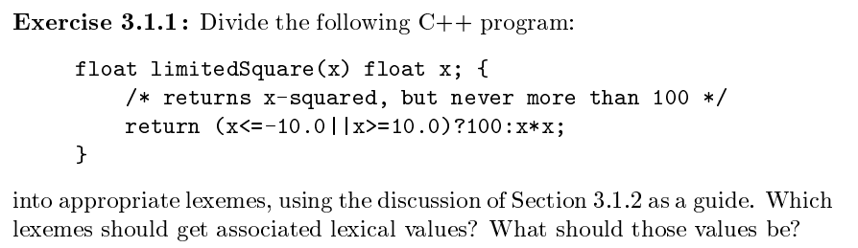
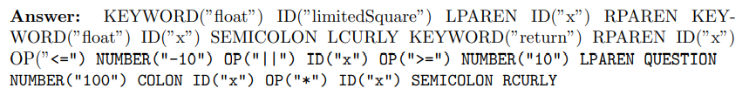
<float> <id, limitedSquaare> <(> <id, x> <)> <{>
<float> <id, x>
<return> <(> <id, x> <op,"<="> <num, -10.0> <op, "||"> <id, x> <op, ">="> <num, 10.0> <)> <op, "?"> <num, 100> <op, ":"> <id, x> <op, "*"> <id, x> <}>

Slide 13
Input buffering
There are mainly two techniques for input buffering:
Buffer pairs
Sentinels
The lexical analysis scans the input string from left to right one character at a time.
Buffer divided into two N-character halves, where N is the number of character on one disk block.
Buffer Pair
: : : E : : = : : Mi : * : :
: C: * : * : 2 : eof : : :
Notes:
In C, single-character operators like -, =, or < could also be the beginning of a two-character operator like ->, ==, or <=.
Thus, we shall introduce a two-buffer scheme that handles large lookaheads safely.
We then consider an improvement involving “sentinels" that saves time checking for the ends of buffers.

Slide 14
Buffer pairs
: C: * : * : 2 : eof : : :
: : : E : : = : : Mi : * : :
: C: * : * : 2 : eof : : :
forward
forward
lexeme_beginnig
Pointer Lexeme Begin, marks the beginning of the current lexeme.
Pointer Forward, scans ahead until a pattern match is found.
Once the next lexeme is determined, forward is set to character at its right end.
Lexeme Begin is set to the character immediately after the lexeme just found.
If forward pointer is at the end of first buffer half then second is filled with N input character.
If forward pointer is at the end of second buffer half then first is filled with N input character.

Slide 15
Buffer pairs
: : : E : : = : : Mi : * : :
: C: * : * : 2 : eof : : :
: C: * : * : 2 : eof : : :
forward
forward
forward
lexeme_beginnig
Code to advance forward pointer
if forward at end of first half then begin
reload second half;
forward := forward + 1;
end
else if forward at end of second half then begin
reload first half;
move forward to beginning of first half;
end
else forward := forward + 1;

Slide 16
Sentinels
: : E : : = : : Mi : * : eof
: C: * : * : 2 : eof : : eof
forward
lexeme_beginnig
In buffer pairs we must check, each time we move the forward pointer that we have not moved off one of the buffers.
Thus, for each character read, we make two tests.
We can combine the buffer-end test with the test for the current character.
We can reduce the two tests to one if we extend each buffer to hold a sentinel character at the end.
The sentinel is a special character that cannot be part of the source program, and a natural choice is the character EOF.

Slide 17
Sentinels
eof
: : E : : = : : Mi : * :
: C: * : * : 2 : eof : : eof
: C: * : * : 2 : eof : : eof
forward
forward
forward
lexeme_beginnig
forward := forward + 1;
if forward = eof then begin
if forward at end of first half then begin
reload second half;
forward := forward + 1;
end
else if forward at the second half then begin
reload first half;
move forward to beginning of first half;
end
else terminate lexical analysis;
end

Slide 18
Specification of tokens

Slide 19
Strings and languages
Term | Definition
Prefix of s | A string obtained by removing zero or more trailing symbol of string S. e.g., ban is prefix of banana.
Suffix of S | A string obtained by removing zero or more leading symbol of string S. e.g., nana is suffix of banana.
Sub string of S | A string obtained by removing prefix and suffix from S. e.g., nan is substring of banana
Proper prefix, suffix and substring of S | The proper prefixes, suffixes, and substrings of a string s are those, prefixes, suffixes, and substrings, respectively, of s that are not ε or not equal to s itself
Subsequence of S | A string obtained by removing zero or more not necessarily contiguous symbol from S. e.g., baaa is subsequence of banana.

Slide 20
Exercise
Write prefix, suffix, substring, proper prefix, proper suffix and subsequence of following string:
String: Compiler

Slide 21
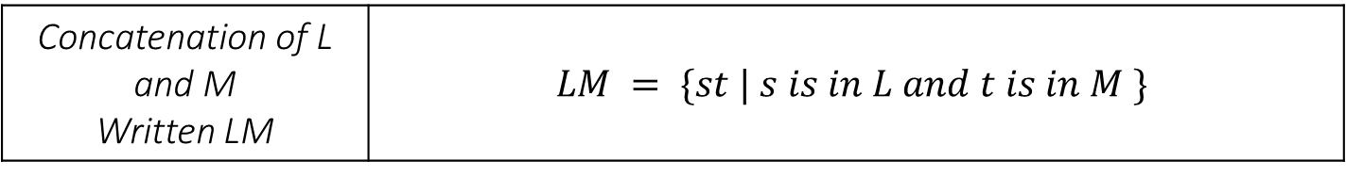
Operations on languages
Operation | Definition
Union of L and M Written L U M | $$L U M = \{s | s is in L or s is in M \}$$
Concatenation of L and M Written LM | $$LM = \{st | s is in L and t is in M \}$$
Kleene closure of L Written L∗ | $$L∗ denotes “zero or more concatenation of” L.$$
Positive closure of L Written L⁺ | $$L+ denotes “one or more concatenation of” L.$$

Slide 22
Example:
Let L be the set of letters {A,B,…..Z,a,b….z} and let D be the set of digits {0,1,…9}.
L U D
LD
L⁴
L*
L(LUD)*
D⁺
is the set of letters and digits | language with 62 strings of length one, each of which strings is either one letter or one digit.
is the set of 520 strings of length two, each consisting of one letter followed by one digit.
is the set of all 4-letter strings
is the set of all strings of letters, including ε, the empty string
is the set of all strings of letters and digits beginning with a letter.
is the set of all strings of one or more digits.

Slide 23
Regular Expression & Regular Definition

Slide 24
Regular Expression for representing the C language Identifiers :
letters_ (letter_ | digit ) *
| - union
* - ‘ Zero or more occurrence of ’

Slide 25
Regular expression
A regular expression is a sequence of characters that define a pattern.
Notational shorthand's
One or more instances: +
Zero or more instances: *
Zero or one instances: ?
Alphabets: Σ

Slide 26
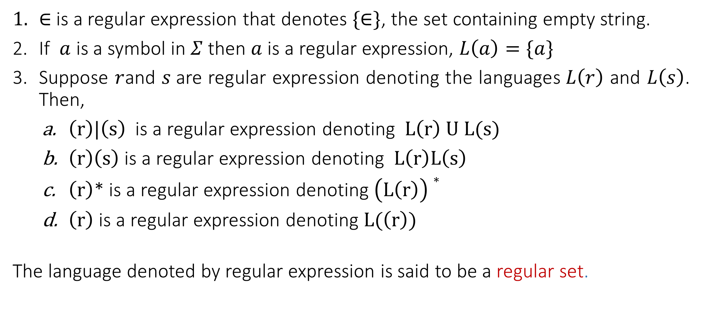
Rules to define regular expression
$∈$is a regular expression that denotes $\{∈\}$, the set containing empty string.
If $a$ is a symbol in $Σ$then $a$ is a regular expression, $L\left(a\right)=\{a\}$
Suppose $r$and $s$are regular expression denoting the languages$L\left(r\right)$ and $L\left(s\right)$. Then,
$\left(r\right)|\left(s\right)$ is a regular expression denoting $L\left(r\right) U L(s)$
$\left(r\right)\left(s\right)$ is a regular expression denoting $L\left(r\right)L\left(s\right)$
$\left(r\right)$* is a regular expression denoting $\left(L\left(r\right)\right)∗$
$\left(r\right)$ is a regular expression denoting $L(\left(r\right))$
The language denoted by regular expression is said to be a regular set.

Slide 27
Regular expression
L = Zero or More Occurrences of a =
a*
*
𝜖
a
aa
aaa
Infinite …..
aaaa
aaaaa…..

Slide 28
Regular expression
L = One or More Occurrences of a =
a⁺
+
a
aa
aaa
Infinite …..
aaaa
aaaaa…..

Slide 29
Precedence and associativity of operators
Operator | Precedence | Associative
Kleene * | 1 | left
Concatenation | 2 | left
Union | | 3 | left
Under these conventions, for example, we may replace the regular expression (a)|((b)*(c)) by a|b*c. Both expressions denote the set of strings that are either a single a or are zero or more b's followed by one c.

Slide 30













Regular expression examples
0 or 1
0 or 11 or 111
String having zero or more a.
String having one or more a.
Regular expression over $Σ=\{a,b,c\}$ that represent all string of length 3.
All binary string
$$Strings: 0, 1$$
$$R.E. =0 | 1$$
$$Strings: 0, 11, 111$$
$$R.E. =0 \left| 11 \right| 111$$
$$R.E. =a∗$$
$$Strings: ε,a, aa, aaa, aaaa…..$$
$$Strings:a, aa, aaa, aaaa…..$$
$$R.E. =a+$$
$$Strings:abc, bca, bbb, cab, aba….$$
$$R.E. =\left(a\left|b\right|c\right) \left(a\left|b\right|c\right) (a\left|b\right|c)$$
$$Strings: 0, 11, 101, 10101, 1111…$$
$R.E. =(0 | 1)$⁺

Slide 31












Regular expression examples
0 or more occurrence of either a or b or both
1 or more occurrence of either a or b or both
Binary no. ends with 0
Binary no. ends with 1
Binary no. starts and ends with 1
String starts and ends with same character
$$Strings:ε,a, aa, abab, bab…$$
$$R.E. =(a | b)∗$$
$$Strings:a, aa, abab, bab, bbbaaa…$$
$R.E. =(a | b)$⁺
$R.E. =(0 | 1)$* $0$
$$Strings: 0, 10, 100, 1010, 11110…$$
$$R.E. =(0 | 1)∗1$$
$$Strings:1, 101, 1001, 10101, …$$
$$Strings: 11, 101, 1001, 10101, …$$
$R.E. =1 (0 | 1)∗$ $1$
$$Strings:00, 101, aba, baab…$$
$$R.E. =1 (0 | 1)∗1 or 0 (0 | 1)∗0$$
$$a (a | b)∗a or b (a | b)∗b$$

Slide 32













Regular expression examples
All string of a and b starting with a
String of 0 and 1 ends with 00
String ends with abb
String starts with 1 and ends with 0
All binary string with at least 3 characters and 3rd character should be zero
Language which consist of exactly two b’s over the set $Σ=\{a,b\}$
$Strings:a,ab,aab,abb$…
$R.E. =a(a | b)$*
$Strings:00,100,000,1000,1100$…
$$R.E. =(0 | 1)∗00$$
$Strings:abb,babb, ababb$…
$$R.E. =(a | b)∗abb$$
$Strings:10,100,110,1000,1100$…
$$R.E. =1(0 | 1)∗0$$
$Strings:000,100,1100,1001$…
$$R.E. =\left(0 | 1\right)\left(0 | 1\right)0(0 | 1)∗$$
$Strings:bb,bab,aabb,abba$…
$$R.E. =a∗b a∗b a∗$$

Slide 33















Regular expression examples
The language with $Σ=\{a,b,c\}$ where $a$ should be multiple of 3
Even no. of 0
String should have odd length
String should have even length
String start with 0 and has odd length
String start with 1 and has even length
All string begins or ends with 00 or 11
$$Strings:aaa, baaa,bacaba,aaaaaa..$$
$$R.E. ={({\left(b|c\right)}^{∗}a{\left(b|c\right)}^{∗}a{\left(b|c\right)}^{∗}a{\left(b|c\right)}^{∗})}^{∗}$$
$Strings:00,0101,0000,100100$….
$$R.E. ={(1^{∗}01^{∗}01^{∗})}^{∗}$$
$Strings:0,010,110,000,10010$….
$$R.E. ={\left(0|1\right) (\left(0 | 1\right)(0|1))}^{∗}$$
$Strings:00,0101,0000,100100$….
$$R.E. ={ (\left(0 | 1\right)(0|1))}^{∗}$$
$Strings:0,010,010,000,00010$….
$$R.E. ={\left(0\right) (\left(0 | 1\right)(0|1))}^{∗}$$
$Strings:10,1100,1000,100100$….
$$R.E. ={ 1(0|1)(\left(0 | 1\right)(0|1))}^{∗}$$
$$Strings: 00101, 10100,110,01011…$$
$$R.E. =(00|11)(0 | 1)∗| \left(0 | 1\right)∗(00|11)$$

Slide 34






Regular expression examples
Language of all string containing both 11 and 00 as substring
String ending with 1 and not contain 00
Language of C identifier
$$Strings: 0011, 1100,100110,010011…$$
$$R.E. ={((0|1)}^{∗}00{(0|1)}^{∗}11{(0|1)}^{∗}) |{ ((0|1)}^{∗}11{(0|1)}^{∗}00{(0|1)}^{∗})$$
$$Strings: 011, 1101,1011….$$
$$R.E. =\left(1 | 01\right)+$$
$$Strings:area, i, redious, grade1….$$
$$R.E. ={(_+L)(_ + L +D)}^{∗}$$
$$where L is Letter \& D is digit$$

Slide 35
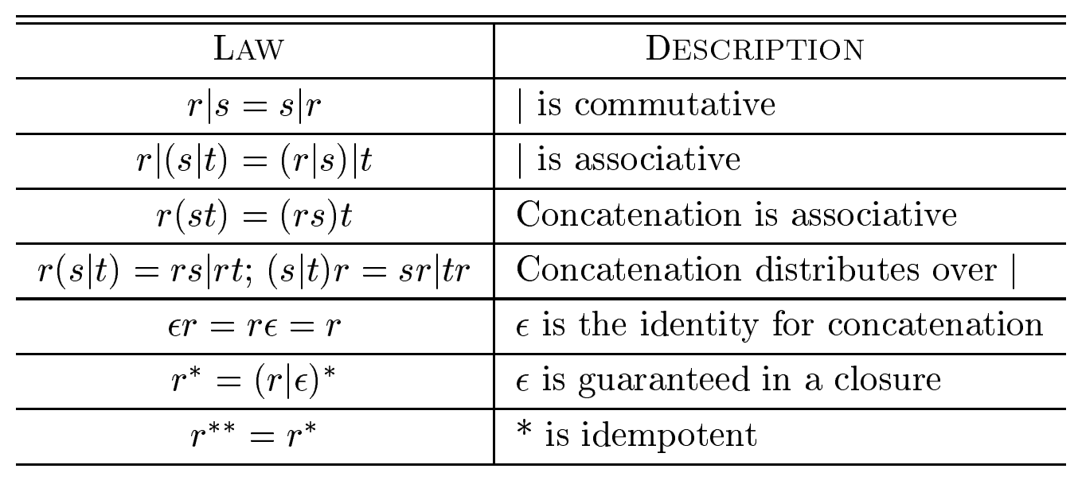
Algebraic laws for regular expressions

Slide 36
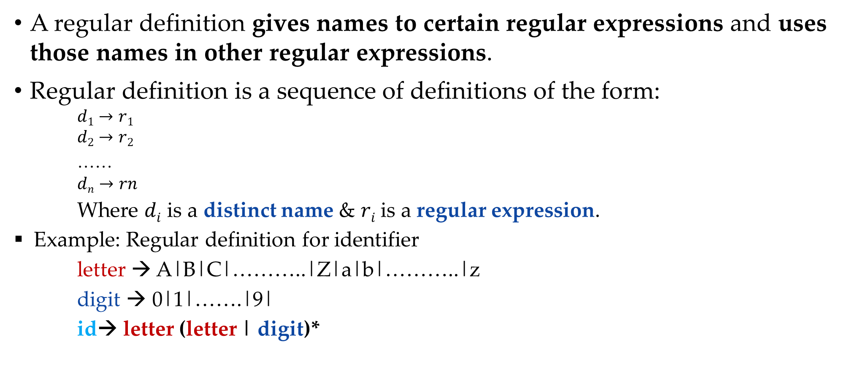
Regular definition
A regular definition gives names to certain regular expressions and uses those names in other regular expressions.
Regular definition is a sequence of definitions of the form:
$$d1→r1$$
$$d2→r2$$
……
$$dn→rn$$
Where $di$ is a distinct name & $ri$is a regular expression.
Example: Regular definition for identifier
letter → A|B|C|………..|Z|a|b|………..|z
digit → 0|1|…….|9|
id→ letter (letter | digit)*

Slide 37
Regular definition example
Example: Unsigned Pascal numbers
3
5280
39.37
6.336E4
1.894E-4
2.56E+7
Regular Definition
digit → 0|1|…..|9
digits → digit digit*
optional_fraction → .digits | 𝜖
optional_exponent → (E(+|-|𝜖)digits)|𝜖
num → digits optional_fraction optional_exponent

Slide 38
Example
C identifiers are strings of letters, digits, and underscores. Here is a regular definition for the language of C identifiers. We shall conventionally use italics for the symbols denied in regular definitions.
letter_ -> A|B|….|Z|a|b|…|z|-
digit -> 0|1|…|9
id -> letter_(letter_ | digit ) *

Slide 39
Transition Diagram

Slide 40
Transition Diagram
A stylized flowchart is called transition diagram.
is a state
is a transition
is a start state
is a final state

Slide 41



Transition Diagram : Relational operator
$$0$$
<
$$1$$
=
2
return (relop,LE)
>
3
return (relop,NE)
=
5
other
4
return (relop,LT)
return (relop,EQ)
>
$$6$$
=
7
return (relop,GE)
other
8
return (relop,GT)

Slide 42
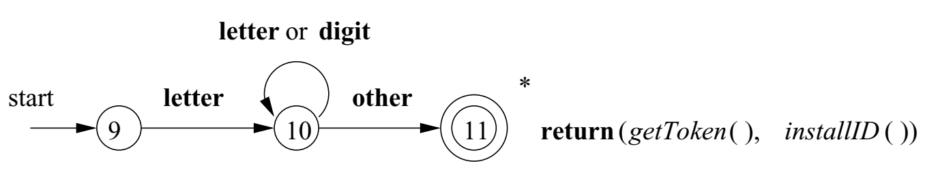

Recognition of Reserved Words and Identifiers
To search for identifier lexemes, this diagram will also recognize the keywords if, then, and else of our running example
There are two ways that we can handle reserved words that look like identifiers:
Install the reserved words in the symbol table initially. When we find an identifier, a call to installID places it in the symbol table if it is not already there and returns a pointer to the symbol-table entry for the lexeme found. The function getToken examines the symbol table entry for the lexeme found, and returns whatever token name the symbol table says this lexeme represents either id or one of the keyword tokens.
Create separate transition diagrams for each keyword; Note that such a transition diagram consists of states representing the situation after each successive letter of the keyword is seen, followed by a test for a \nonletter-or-digit,“ i.e., any character that cannot be the continuation of an identifier.

Slide 43
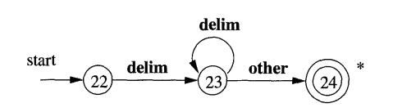







Transition diagram : Unsigned number
digit
digit
digit
start
$$1$$
digit
$$2$$
.
digit
E
+or -
digit
other
8
$$3$$
$$4$$
$$5$$
$$6$$
$$7$$
E
digit
3
5280
39.37
1.894 E - 4
2.56 E + 7
45 E + 6
96 E 2
9
10

Slide 44
Hard coding and automatic generation lexical analyzers
Lexical analysis is about identifying the pattern from the input.
To recognize the pattern, a transition diagram is constructed.
It is known as a hard coding lexical analyzer.
Example: to represent an identifier in ‘C’, the first character must be a letter and the other characters are either letters or digits.
To recognize this pattern, a hard coding lexical analyzer will work with a transition diagram.
The automatic generation lexical analyzer takes special notation as input.
For example, the lex compiler tool will take a regular expression as input and find the pattern matching that regular expression.
Letter or digit
Start
Letter
1
2
3

